Slide 1
IoT Application with Data Logging and Reporting
Vraj Suratwala
Department of ICT, VNSGU

Slide 2
Introduction
Data Logging in IoT is the process of automatically collecting, storing, and maintaining data generated by sensors or IoT devices.
Reporting is the process of analyzing the collected data and presenting it in a meaningful form, such as tables, graphs, charts, dashboards, or reports.
Sensor → Data Collection → Data Logging → Data Processing → Reporting

Slide 3
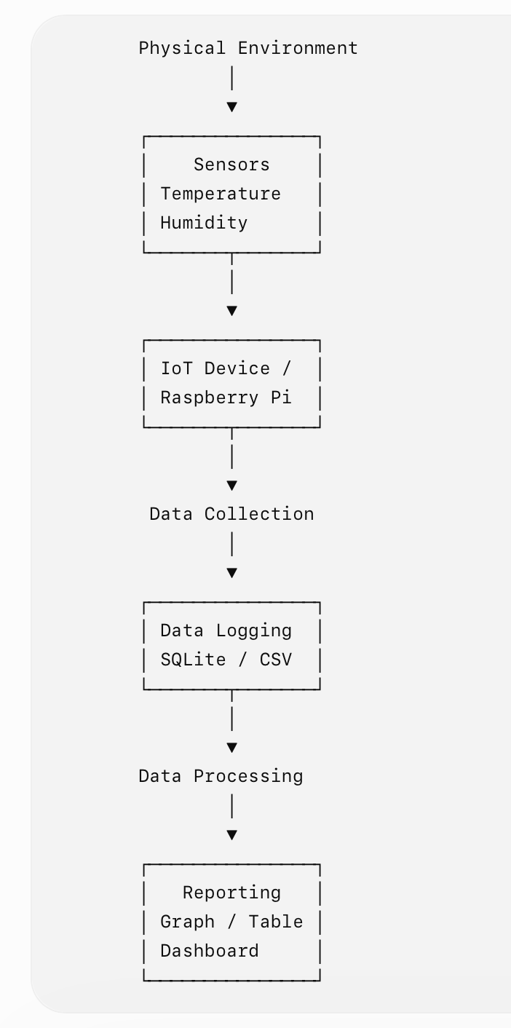
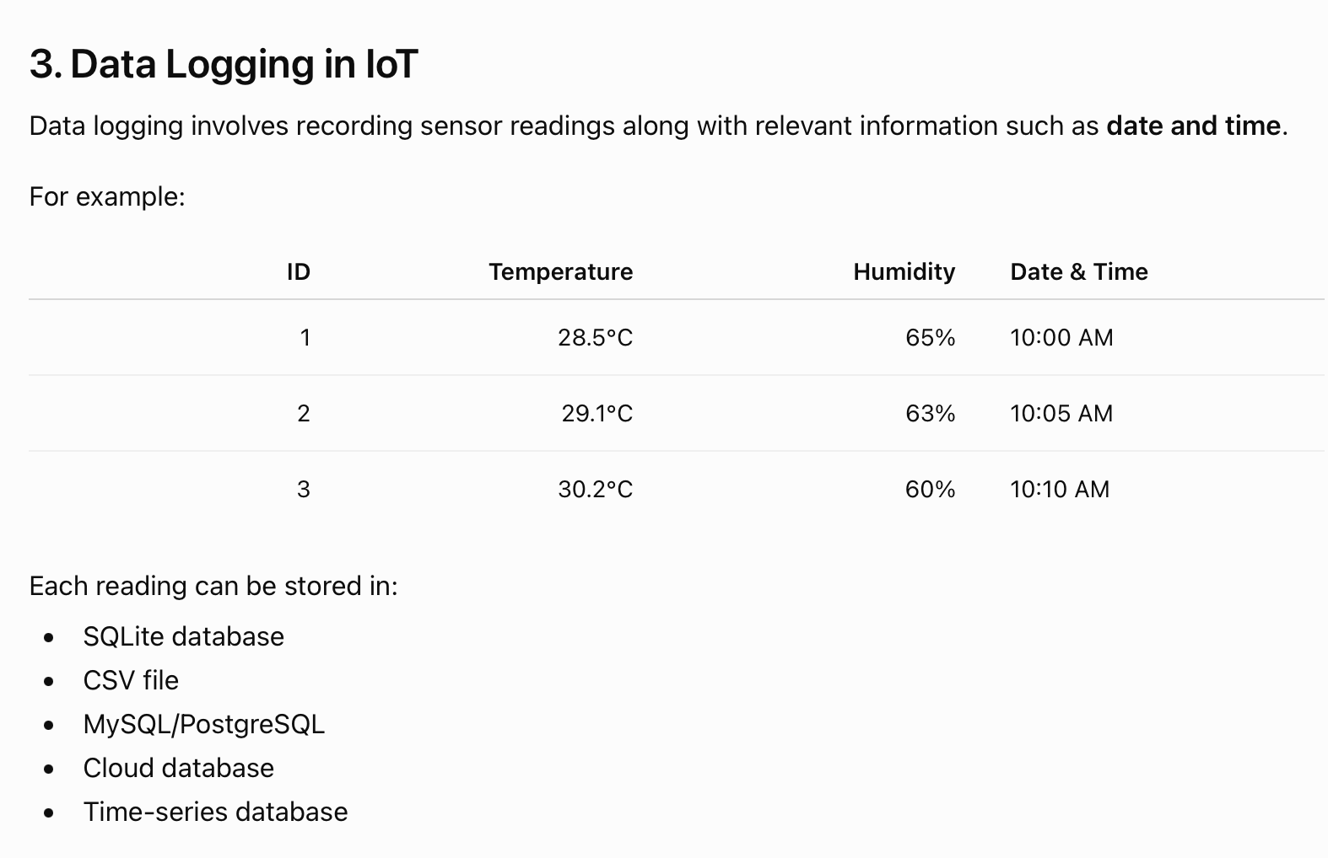
Architecture & Data Logging

Slide 4
Steps in IoT Data Logging
Step 1 — Data Collection
  Sensors measure physical parameters such as:
  Temperature
  Humidity
  Pressure
  Light
  Motion
  Gas concentration

Slide 5
Step 2 — Data Transmission
The sensor sends the data to an IoT device or gateway using protocols/interfaces such as:
  GPIO
  I2C
  SPI
  UART
  Wi-Fi
  Bluetooth
  MQTT
Step 3 — Data Storage
  The collected data is stored locally or in the cloud.
  For example:
  Sensor → Raspberry Pi → SQLite

Slide 6
Step 4 — Data Processing
  The system can calculate:
  Average
  Minimum value
  Maximum value
  Count
  Threshold violations
Step 5 — Reporting
  The processed information is presented using:
  Tables
  Graphs
  Charts
  Dashboards
  PDF/CSV reports

Slide 7
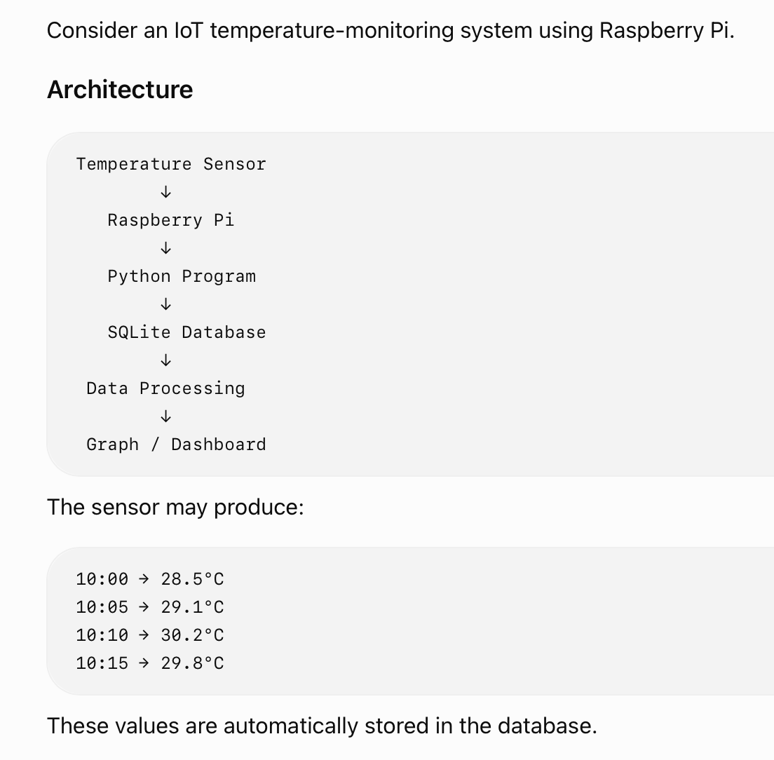
Example : Temrature Data Logging

Slide 8
SQLite Table for Data Logging
A table can be created as:
  CREATE TABLE SensorData (
  id INTEGER PRIMARY KEY AUTOINCREMENT,
  temperature REAL,
  humidity REAL,
  timestamp DATETIME
  );
Insert Sensor Reading
  INSERT INTO SensorData (temperature, humidity, timestamp) VALUES (28.5, 65, CURRENT_TIMESTAMP);

Slide 9
Reporting in IoT
Reporting converts raw logged data into information that can be easily understood by users.
For example, instead of showing hundreds of individual readings:
28.5
29.1
30.2
29.8
30.5 ....

Slide 10
a report can show:
Maximum Temperature : 31.2°C
Minimum Temperature : 28.5°C
Average Temperature : 29.9°C
A graphical report could show:
Temperature
│
32 │ ●
31 │ ●
30 │ ● ●
29 │ ●
28 │ ●
└────────────────────
Time →

Slide 11
Types of IoT Reports
1. Tabular Report
  Data is represented in rows and columns.
2. Graphical Report
Data is represented using:
  Line graphs
  Bar charts
  Pie charts
  Area charts
3. Dashboard
  A dashboard provides real-time or historical information in a single interface.

Slide 12
Summary
Sensor
↓
IoT Device
↓
Data Collection
↓
Data Logging
↓
Database
↓
Data Processing
↓
Reporting
↓
Dashboard / User

Slide 13
Thank You
Vraj Suratwala
Department of ICT, VNSGU

